Slide 1

TCS INDUSTRY PROJECT - THIRD YEAR ‘ D-10 ’
Suspicious Activity Detection
Real-Time Surveillance Architecture
SR NO. | NAME | PRN | ROLL NO.
1 | ISHA KOMERVELLIWAR | 22310683 | 324027
2 | RITU PATIL | 22310761 | 324029
3 | BHAKTI SARAP | 22310826 | 324032
4 | JAYDIP CHAVAN | 22310913 | 324033

Slide 2

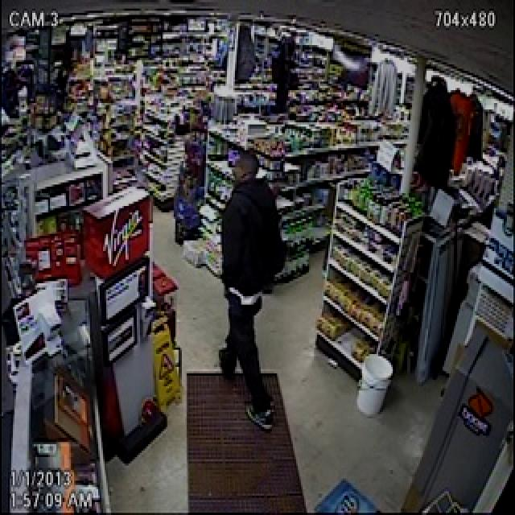
Shoplifting & Surveillance Limitations
→
The Core Problem: Shoplifting accounts for massive inventory loss annually.
→
Human Limitation: Security guards cannot monitor 50+ streams simultaneously.
→
Reactive Failure: Reviewing footage after theft is too late.
→
Proposed Solution: AI Co-Pilot for proactive, real-time security alerts.

Slide 3





4-Pillar Modular Architecture
Trajectory
Concealment
Hand-in-Bag
Pocketing
BoT-SORT tracking with persistence buffer.
Custom YOLOv12n for Hoodie detection.
Sensor fusion: Pose + Object Detection.
Action Recognition & Pose Heuristics.
Built with Python 3.9+, Ultralytics YOLO, and Streamlit for modularity.

Slide 4
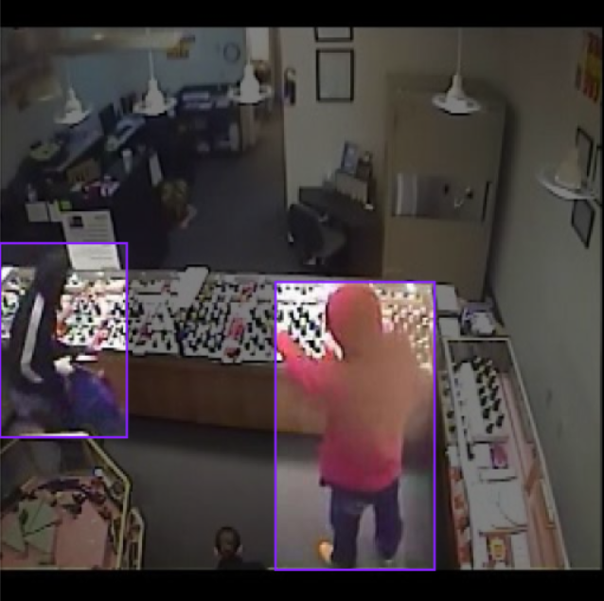
Module 1: Face Concealment
Custom Data Engineering
→
Dataset Mining: 3,959 images custom-mined from UFC Crime Dataset (No pre-existing high-quality sets found).
→
Architecture: Trained YOLOv12n (Nano) for 300 epochs on Kaggle Cloud GPUs.
→
Inference: Optimized for high mAP on classes: Normal (0) and Hoodie (1).

Slide 5
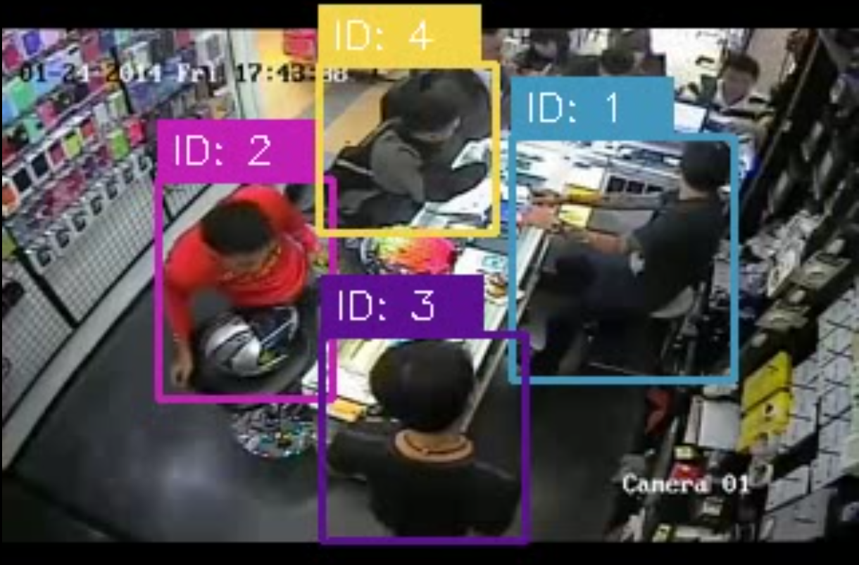
MODULE 2: CUSTOMER TRAJECTORY
BoT-SORT with ReID
→
Uses Re-Identification (ReID) for ID persistence.
→
120-Frame Buffer: Retains unique IDs for ~4 seconds even during occlusion behind store shelves.
→
Identifies loitering and abnormal circulation paths.

Slide 6

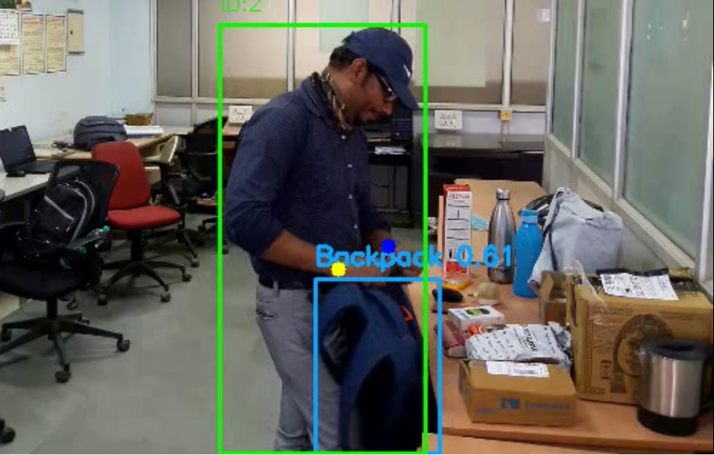
Module 3: Action Recognition
Heuristic: Hand in Personal Bag
Detecting the highly suspicious gesture of placing a hand into a non-store backpack/handbag.
Sensor Fusion
→
YOLO12n: Tracks Bounding Boxes for Backpack/Handbag.
→
YOLO11n-Pose: Tracks 17 Human Keypoints.
→
Intersection Logic: Fusing Wrist Keypoints with Bag BBox.

Slide 7
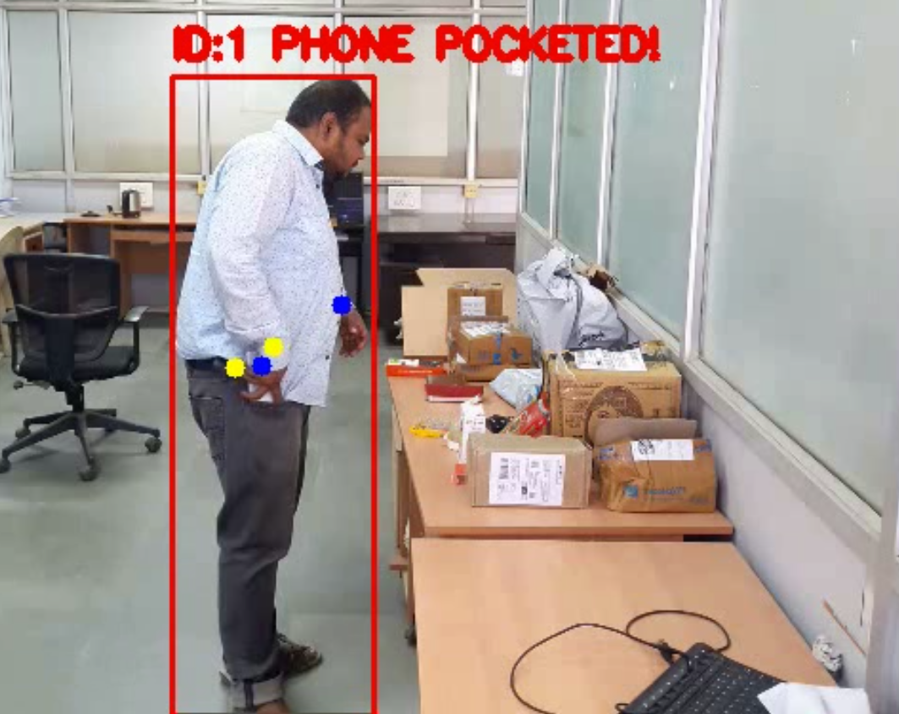
Module 4: Pocketing Logic
Multi-Stage Heuristic
→
Stage 1 (Held): Euclidean distance between Wrist & Object < Threshold.
→
Stage 2 (Memory): 60-frame buffer remembers the item even if obscured by the hand.
→
Stage 3 (Pocketed): Final check of Wrist distance to Hip Keypoint triggers "ITEM POCKETED".

Slide 8


STRATEGIC POC VALIDATION
Data Engineering Realities
The Logic is the Achievement
Training object detection for 10,000+ unique supermarket SKUs (razors, cosmetics, snacks) is a corporate data-engineering task, not a research-level logic milestone.
We used Cell Phones (COCO class 67) as a deliberate proxy. The specific item is irrelevant; the success lies in the fusion of Pose Estimation + Object Tracking + Temporal Heuristics.
We deliberately bypassed this bottleneck to focus on the computational complexity of the action recognition pipeline.
Our architecture is Weight-Agnostic: Simply swap item weights to deploy in any retail environment.

Slide 9
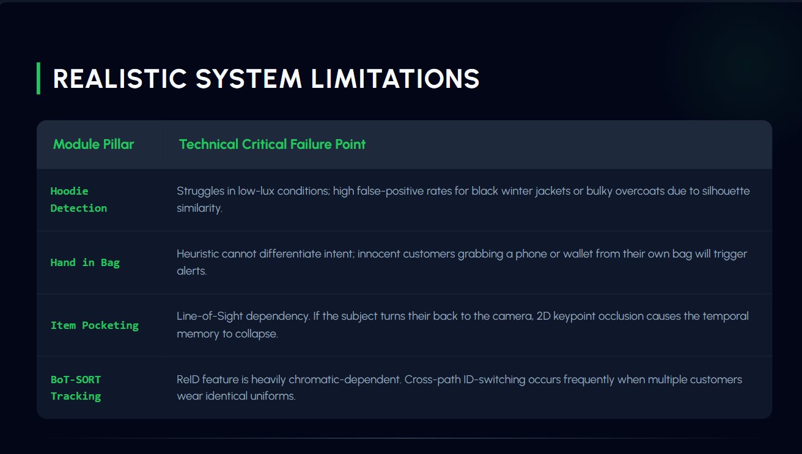

Slide 10

Thank You
Suspicious Activity Detection Pipeline
Questions & Feedback?
TCS Industry Project
Edge AI Vision

Slide 11
DATASET AND CODEBASE
https://github.com/codepool1437/suspicious-activity-detection/
Source: github.com
https://universe.roboflow.com/jaydips-workspace/person-with-hoodie-detection/browse?queryText=&pageSize=50&startingIndex=0&browseQuery=true
Source: roboflow.com
https://drive.google.com/drive/folders/1GjOLezeuBzys1ivUccTUHrPrp8QYmo5n
Source: drive.google.com

